Slide 1

Smart Recipe Generator – What's in My Fridge?
Team: Tri Techies
Saran S • Sathya R V • Tharun Pranav T

Slide 2



Transforming Your Kitchen Experience
AI-Powered Intelligence
Instant Suggestions
Daily Cooking Made Easy
Advanced recipe generator that understands your needs and preferences instantly
Simply input your available ingredients and receive personalized recipe recommendations
Eliminates the daily struggle of deciding what to cook with what you have

Slide 3


Solving Real Kitchen Challenges
The Problem
Our Solution
Home cooks frequently find themselves staring at their fridge, unsure what to make with limited or random ingredients available.
Our intelligent tool leverages AI technology to instantly generate creative, practical recipes based on your exact ingredients.
This leads to food waste, repeated meals, and cooking frustration.
Transform uncertainty into culinary inspiration with just a few clicks.

Slide 4

Core Features & Functionality
1
2
3
Intelligent Ingredient Input
Dual Selection Method
Surprise Me Feature
Flexible input system allows users to type ingredients or select from comprehensive dropdown menus for accuracy and speed.
Choose ingredients through convenient dropdown selection or free-text input to accommodate different user preferences and cooking styles.
Feeling adventurous? Let our AI surprise you with completely random, creative recipes that introduce new flavors and techniques.

Slide 5




Seamless User Experience
Secure Login
Start with personalized credentials to save preferences and cooking history
Dietary Preferences
Select your preferred cooking style: vegetarian or non-vegetarian options
Input Ingredients
Add your available ingredients using our intuitive input system
Instant Results
Receive personalized, detailed recipe suggestions tailored to your inputs

Slide 6
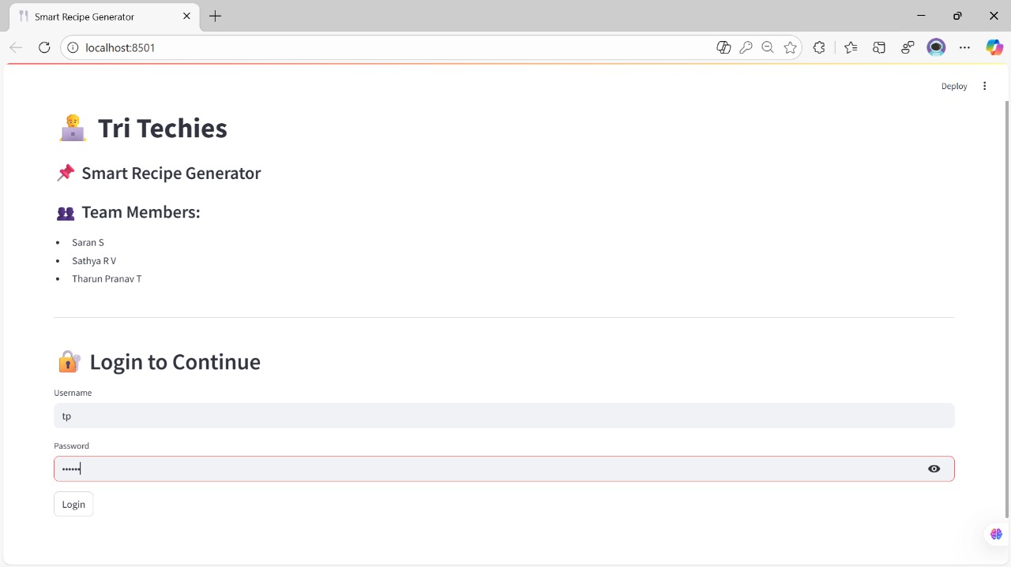
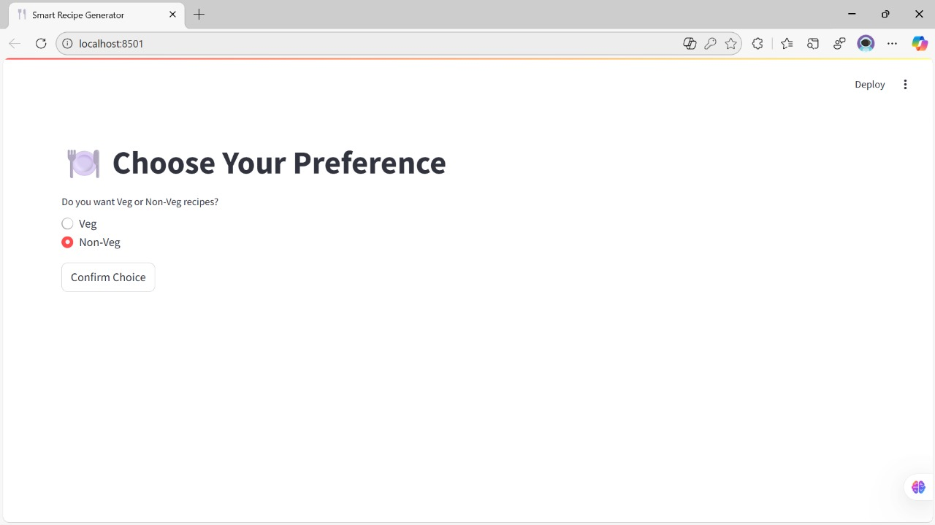
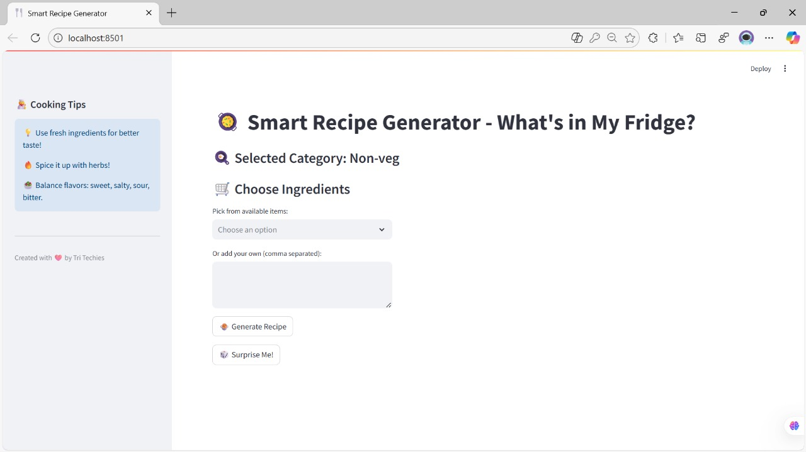
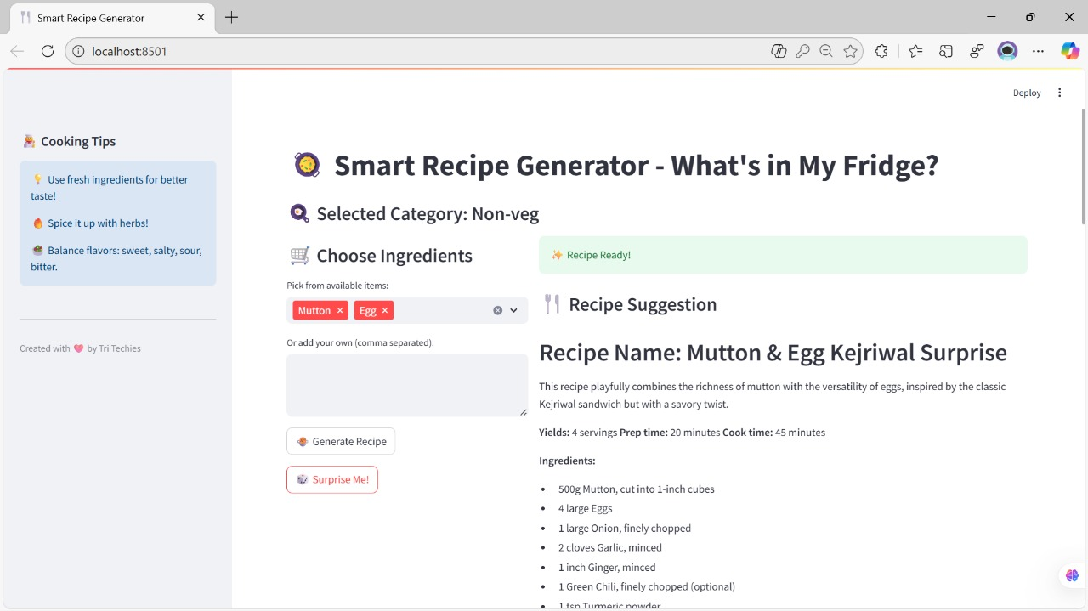

Slide 7

Creative Development Process
AI-Assisted Ideation
We leveraged cutting-edge AI tools including ChatGPT and Gemini for comprehensive brainstorming sessions.
This collaboration helped us map out optimal project flow, user interface concepts, and feature prioritization.
Rapid prototype generation
User experience optimization
Feature validation and refinement

Slide 8



Technical Implementation
Python Foundation
Google Gemini API
Streamlit UI
Built the core application logic using Python's robust libraries and frameworks for reliable, scalable performance.
Integrated Google's powerful Gemini API to generate intelligent, contextual recipe suggestions with natural language processing.
Implemented Streamlit framework to create an intuitive, responsive user interface that makes recipe generation effortless.

Slide 9

Refinement & Testing Excellence
01
02
AI-Assisted Debugging
Comprehensive Testing
Utilized AI tools for systematic debugging and code optimization, ensuring robust performance across all features.
Conducted extensive testing scenarios for both vegetarian and non-vegetarian recipe generation, validating accuracy and variety.
03
Enhanced Interactivity
Refined user authentication system and dropdown functionality to create a seamless, engaging cooking experience.

Slide 10

Impact & Future Vision
Current Benefits
Future Enhancements
Time Efficiency
Nutritional Intelligence
Dramatically reduces meal planning time from hours to minutes
Comprehensive nutrition information and dietary tracking for each recipe
Waste Reduction
Global Accessibility
Maximizes ingredient utilization, minimizing food waste and saving money
Multi-language support to serve diverse cooking communities worldwide
User-Friendly Design
Mobile Innovation
Intuitive interface accessible to cooks of all skill levels
Native mobile app for on-the-go recipe generation and grocery integration

Slide 11

Innovation Meets Practicality
AI Technology
Creative Problem-Solving
Practical Impact
Cutting-edge artificial intelligence at your fingertips
Innovative approach to everyday kitchen challenges
Real solutions for real cooking needs

Slide 12


GitHub
Scan this QR code to view this project on GitHub

Slide 13

Thank you
Thank you for joining our culinary innovation journey!
Tri Techies: Transforming kitchens through technology

